Slide 1
OSCE Question
7-6-2017
YCH

Slide 2
Question 1
53/ F
Dizziness and vomiting
Hx of DM, HT, gallstones , renal impairment
BP 90/54 P 80

Slide 3
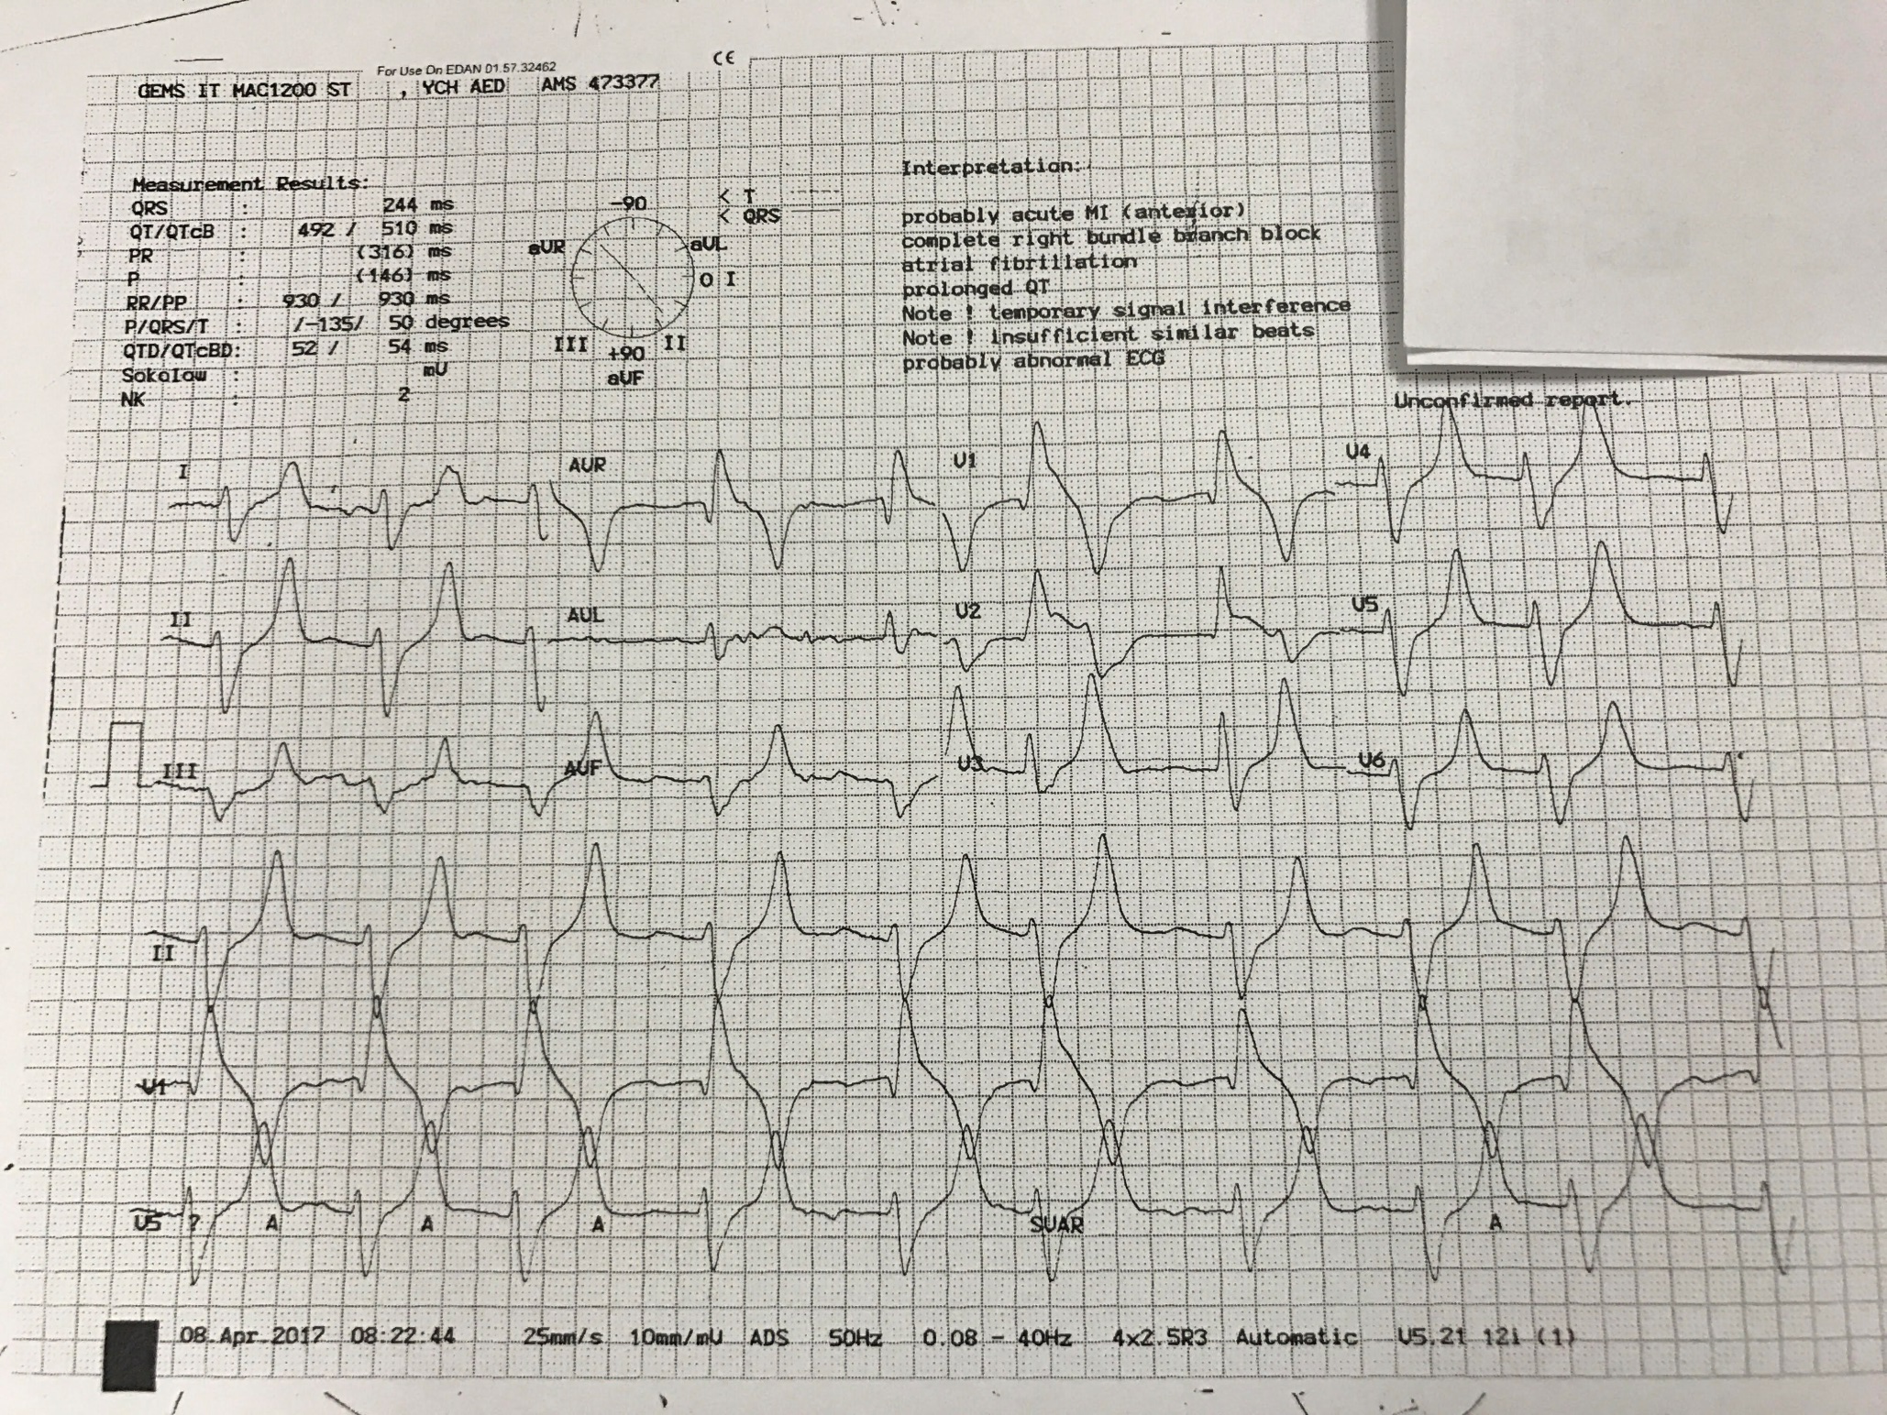

Slide 5
a/ What are the ECG abnormalities?
RAD
Widened and Flattened P
Prolonged PR interval
Widen QRS
Peaked T wave
b/ What is the diagnosis?
Hyper K vs Na Channel blocking

Slide 6
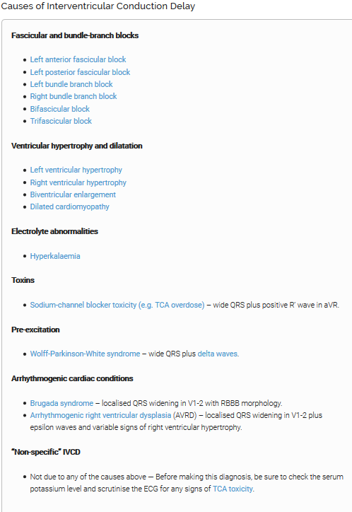
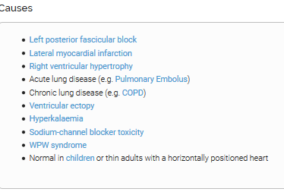
of RAD

Slide 7
HyperK ECG
Flattened P and widen PR
Peaked T wave
ABG pH 7.1 K 9.1
No clinical features of Anticholingeric

Slide 8
Serum potassium > 5.5 mEq/L is associated with repolarization abnormalities:
Peaked T waves (usually the earliest sign of hyperkalaemia)
Serum potassium > 6.5 mEq/L is associated with progressive paralysis of the atria:
P wave widens and flattens
PR segment lengthens
P waves eventually disappear
Serum potassium > 7.0 mEq/L is associated with conduction abnormalities and bradycardia:
Prolonged QRS interval with bizarre QRS morphology
High-grade AV block with slow junctional and ventricular escape rhythms
Any kind of conduction block (bundle branch blocks, fascicular blocks)
Sinus bradycardia or slow AF
Development of a sine wave appearance (a pre-terminal rhythm)
Serum potassium level of > 9.0 mEq/L causes cardiac arrest due to:
Asystole
Ventricular fibrillation

Slide 9
c/ How would you manage the patient?
Iv Ca
DI drip , salbutamol (nebuliser/ iv )
NaHCO3 : depends on volume status
Resonium
Lasix ( +/- NS ) : depends on renal function and volume status
Hemodialysis
ICU consultation

Slide 10
d/ What is the underlying cause?
Metformin induced lactic acidosis
Acute on chronic renal failure with hyperK
Patient admitted ICU , hemodialysis done
Off metformin

Slide 11
Question 2
27/F, Good Past health
dizziness, limbs twitching while on duty
On Arrival
GCS E4V1M5
R eye deviated to Right, drooling saliva

Slide 12
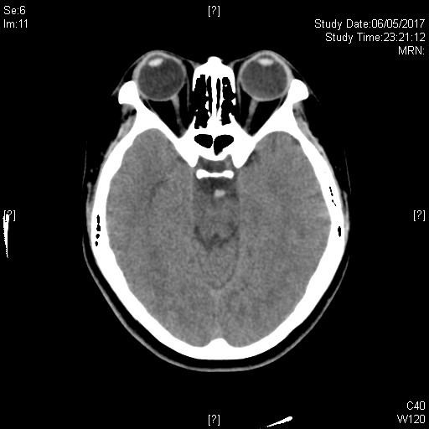
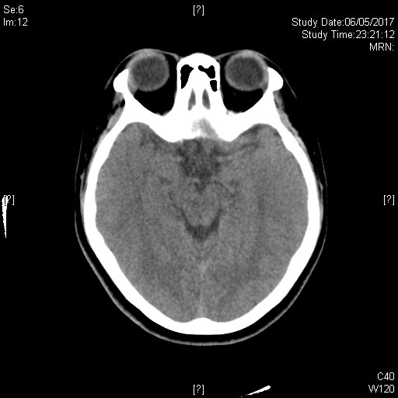
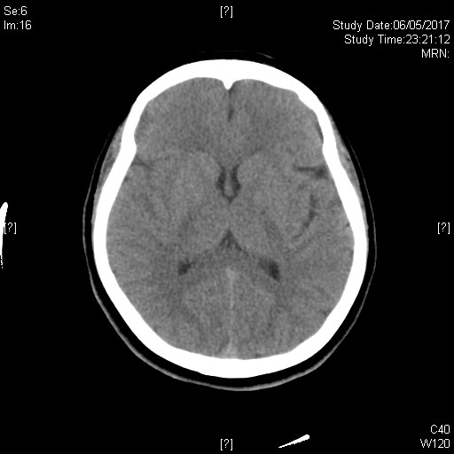

Slide 13
a/ What is the CT finding?
Hyperdense basilar artery
b/ What is the diagnosis?
Acute basilar artery occulsion
c/ How would you manage the patient?
ABC
Admit stroke ward/ ICU
Arrange thrombolytic

Slide 14
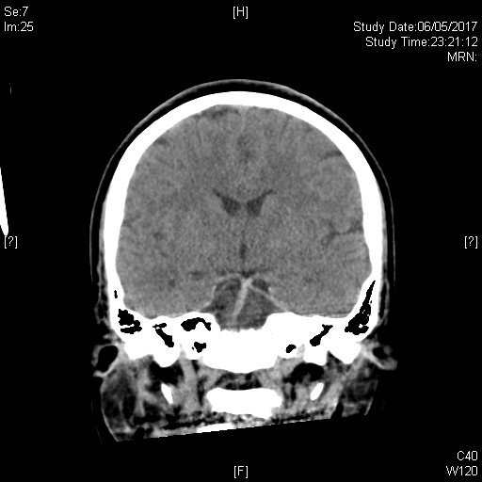

Slide 15
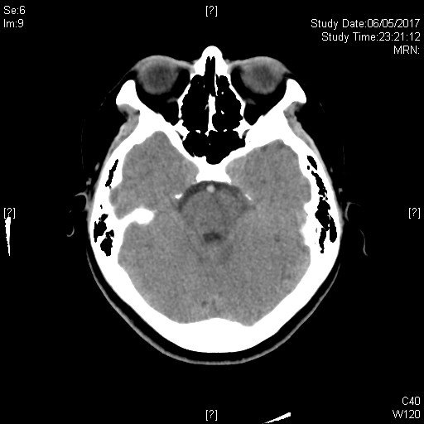
On Admission
Day 2

Slide 16
Question 3
25/ M
S/F with R hand contusion
T+ swelling over radial side of right hand

Slide 18
a/ What is the x ray finding and diagnosis ?
small radio-opacity over trapezium
Trapezium #
b/ What is the associated injury ?
Scaphoid
c/ How would you manage the patient?
Thumb spica x 4-6 weeks for undisplaced #

Slide 19
Q4. 56/F, present with sudden onset floater and flashing

Slide 20
a/ What is the USG finding(s) ?
bright, continuous, smooth and folded membrane within the vitreous
b/ What is the diagnosis?
Retinal detachment
c/ How would you manage the patient?
VA , visual field, fundoscopy
Urgent Eye consultation

Slide 21
Question 5
40/M
LBP x few months
No Hx of injury

Slide 22
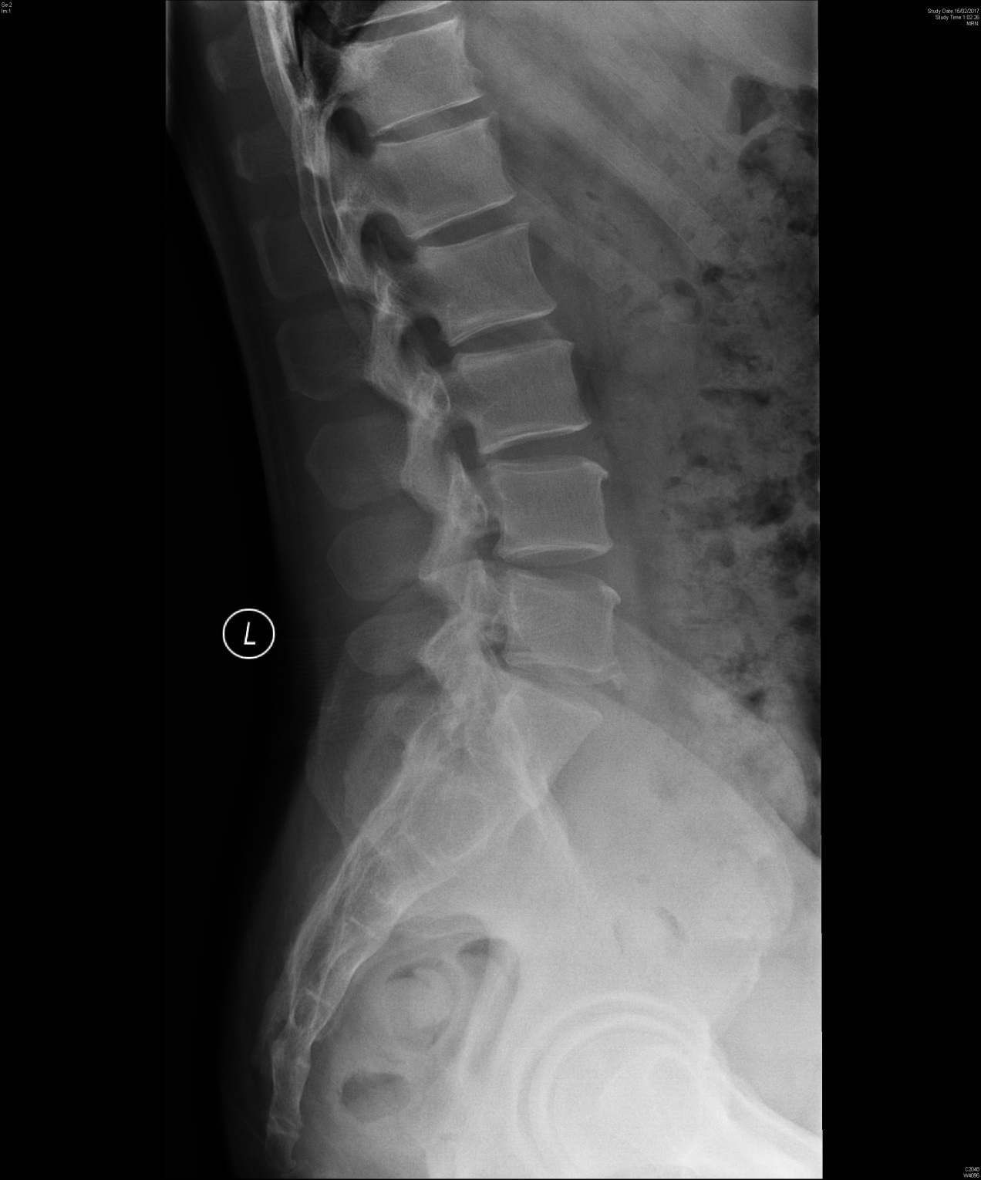

Slide 23
a/ What are the x ray findings?
Bilateral SIJ fusion
Degenerative change of lumbar spine
b/ What is the diagnosis?
Ankylosing spondylitis
c/ What associated feature(s) you would look for?
Anterior uveitis
Psoriasis
Aortic regurgitation
Inflammatory bowel disease
d/ How would you manage the patient?
Blood x ESR, CRP , HLA-B27
NSAIDs
Refer medical OPD

Slide 24
Thank you

